Slide 1
Predicting Deer Age via Computer Vision
9/25/2025

Slide 2
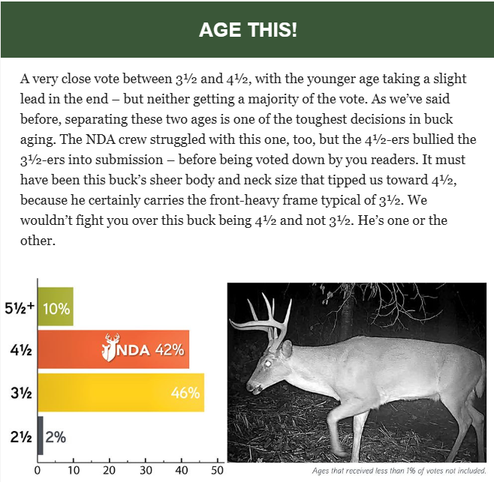
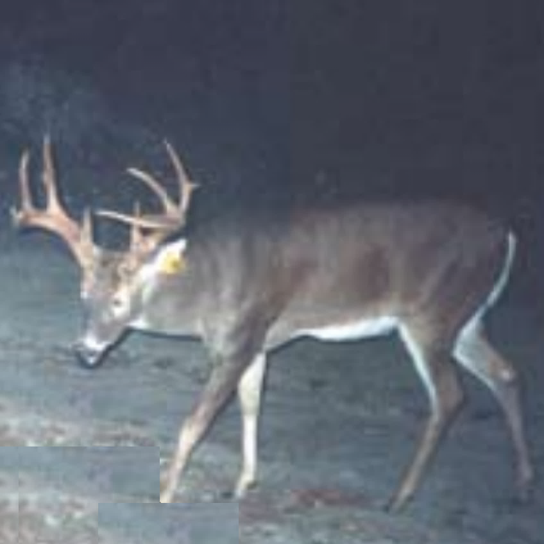
Data collection
Data collected through various sources
Prediction error statistics
NDA age estimate
Reason / description
250116_241016_VA_2p5_NDA
Image recorded date
Image taken date
Image location (state)
Agency-determined age
Agency acronym
Notes:
In addition to other resources (ex. Youtube, Facebook, etc.), the National Deer Association’s “Age This!” surveys provide much of the initial data.
Each week, results from the previous week’s survey provide two items:
An aged deer photo with explanation of why the decision was made
Statistics on how others voted for the previous week’s survey.
The former provides images, its metadata stored within the filename for each image.
The latter provides statistics for human prediction accuracy, also collected for each image.

Slide 3
Standardization
Data collected through various sources
Resized images stored; info stored in metadata
ML models expect squared input (ex. ResNet expects 224x224)
Similarly, images in the dataset are cropped to a square
The crop aims to include as much of the deer as possible
Only body contours matter in the crop; antlers / background are not considered
250116_241016_VA_2p5_NDA.png
Notes:
We know a priori that computer vision models like ResNet expect square images of 224x224 resolution.
Therefore, initial images are captured, cropped, and formatted to fit the 1:1 aspect ratio requirements.
Cropping is done with respect to the deer’s body, not the antlers or background
This forces the model to only consider body composition, dimensions, and pose rather than antler size or location.

Slide 4
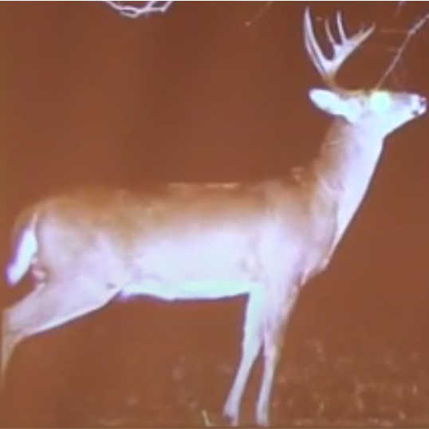
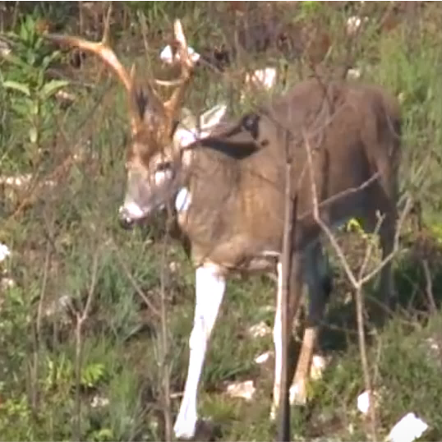
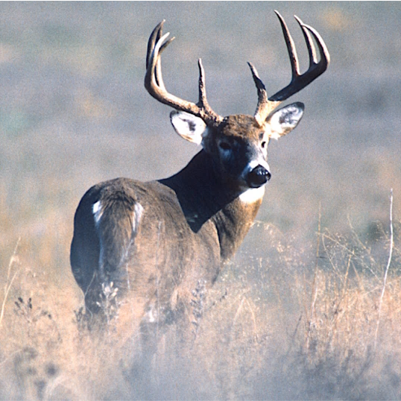
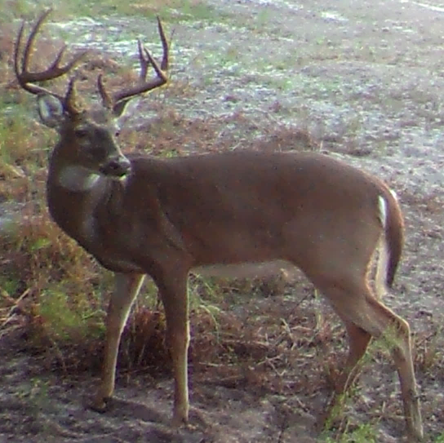
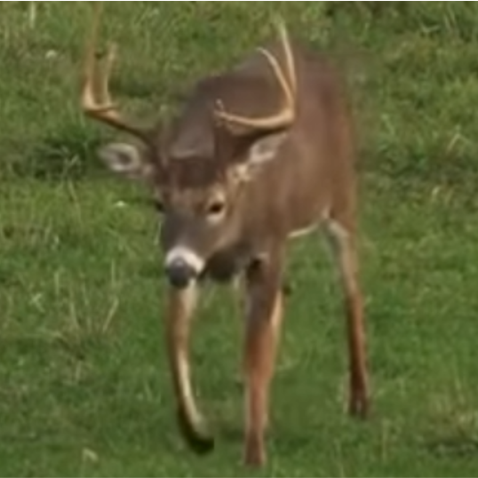
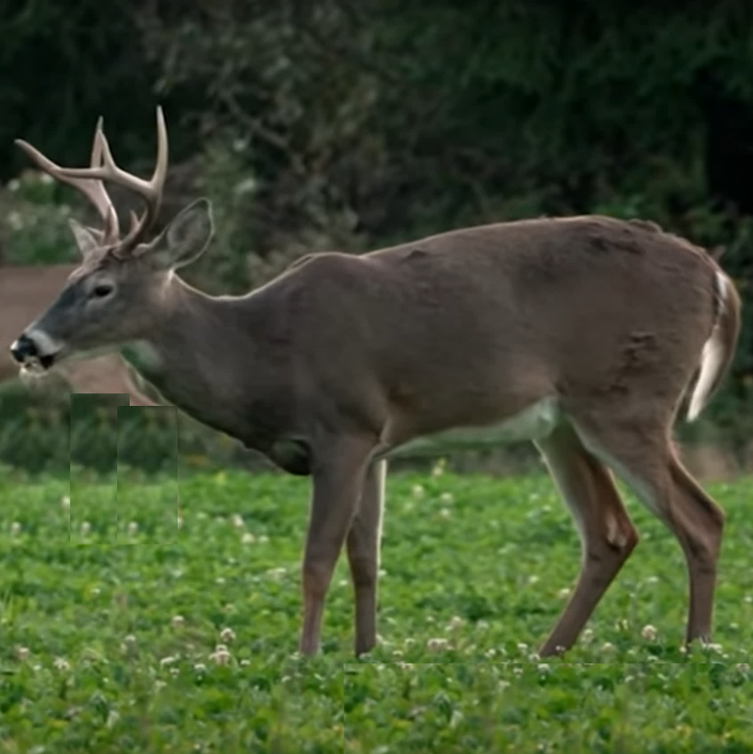
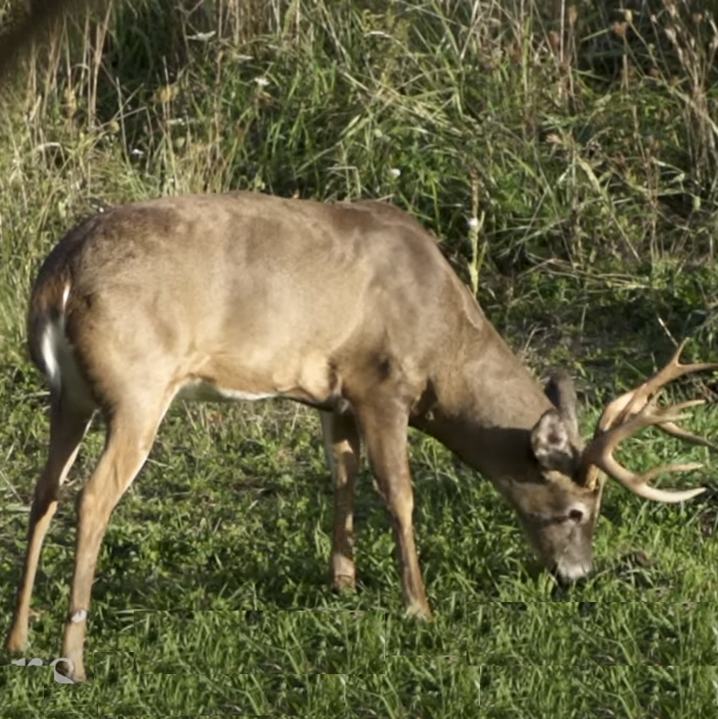
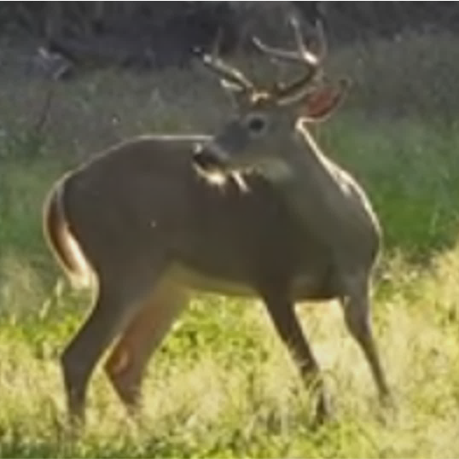
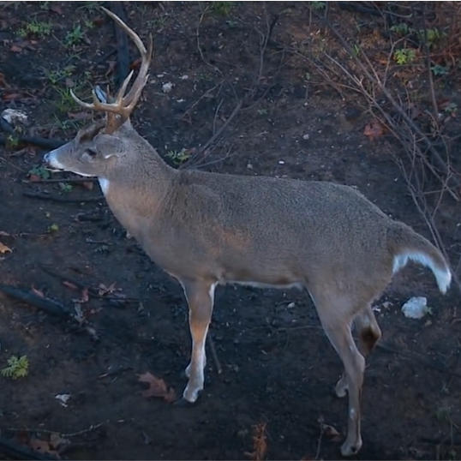
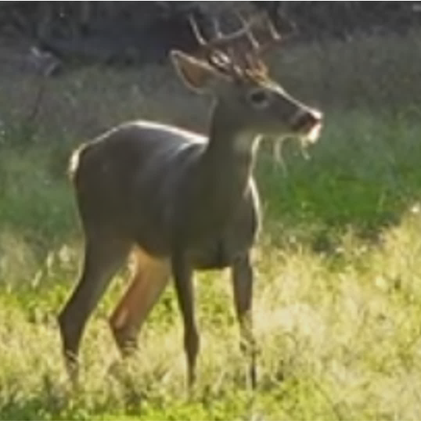
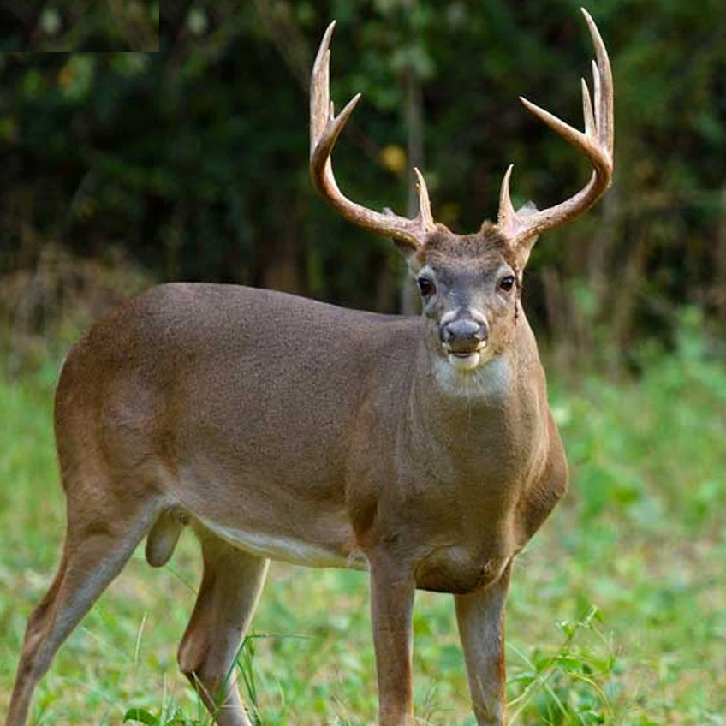
Deployment
Data collected through various sources
Resized images stored; info stored in metadata
Python collects, interpolates images
224
224
Notes:
During model execution, Python collects the square-cropped images, interpolating each image to 224x224 (the image size expected by ResNet)
Examples of deer in different backgrounds, poses, ages, and locations are shown, illustrating the diversity of the dataset.

Slide 5
Deployment
Data collected through various sources
Resized images stored; info stored in metadata
Python collects, interpolates images
Model development
Train
Validation
Test
Ensemble
5 folds
Each augmented
Each ResNet-18
Evaluate
F1
A1
R1
Tuned ensemble
Inference
Error analysis
Notes:
The dataset is broken into a training, validation, and held-out test set.
The training set is broken into five data splits, each referred to as a “fold”
Each fold is augmented with perfect class balancing and fed to a ResNet-18 model.
The models are ensembled together to create a single model.
The single model is evaluated via the validation set, and hyperparameters are tuned to optimize the ensemble weights
The tuned ensemble is analyzed using the held-out, non-augmented test data

Slide 6
Deployment
Data collected through various sources
Resized images stored; info stored in metadata
Python collects, interpolates images
Model development
Optimal model stored on Dropbox (.pth)
Data input by user via website
Data transferred to model via Railway
Tuned ensemble
Predictions returned to user via website

Slide 7
Deployment
Data collected through various sources
Resized images stored; info stored in metadata
Python collects, interpolates images
Model development
Optimal model stored on Dropbox (.pth)
Data input by user via website
Data transferred to model via Railway
Predictions returned to user via website

Slide 8
Deployment
Data collected through various sources
Resized images stored; info stored in metadata
Python collects, interpolates images
Model development
Optimal model stored on Dropbox (.pth)
Data input by user via website
Data transferred to model via Railway
Predictions returned to user via website

Slide 9
Deployment
Data collected through various sources
Resized images stored; info stored in metadata
Python collects, interpolates images
Model development
Optimal model stored on Dropbox (.pth)
Data input by user via website
Data transferred to model via Railway
Predictions returned to user via website

Slide 10
Deployment
Data collected through various sources
Resized images stored; info stored in metadata
Python collects, interpolates images
Model development
Optimal model stored on Dropbox (.pth)
Data input by user via website
Data transferred to model via Railway
Predictions returned to user via website

Slide 11
Data collection
Metadata
250202_230916_KY_3p5_NDA
Image recorded date (YY-MM-DD)
Image taken date
Image location (state)
Agency-determined age
Agency acronym
250116_241016_VA_2p5_NDA
240723_241107_KS_4p5_NDA
250202_230916_KY_3p5_NDA
250521_240909_WV_4p5_NDA
241219_241012_TX_3p5_NDA
250707_240918_WV_4p5_NDA
250603_241113_TX_3p5_NDA
250803_240708_IN_4p5_NDA
250906_250713_IN_3p5_NDA

Slide 12
Date | Model | Img size | Img type | Validation | Test | Metric | Filename
7/2/25 | Ensemble | 244 x 244 | Color | - | - | - | trailcam_ensemble
9/18/25 | EfficientNet-B5 | 512 x 512 | BW / Color | 80.4% | 78.4% | 0.63 | 251809_enb5

Slide 13
Extra images

Slide 14
ResNet-18
Model 1
Fold 1
Model 1 TTA (Original + Flip) → Avg. Prediction
ResNet-18
Model 2
Fold 2
Model 2 TTA (Original + Flip) → Avg. Prediction
Original image
Input
224 x 224 x 3
Deer image
ResNet-18
Model 3
Fold 3
Model 3 TTA (Original + Flip) → Avg. Prediction
Ensemble Agg.
SoftMax average
Final Prediction
Flipped image
ResNet-18
Model 4
Fold 4
Model 4 TTA (Original + Flip) → Avg. Prediction
ResNet-18
Model 5
Fold 5
Model 5 TTA (Original + Flip) → Avg. Prediction

Slide 15
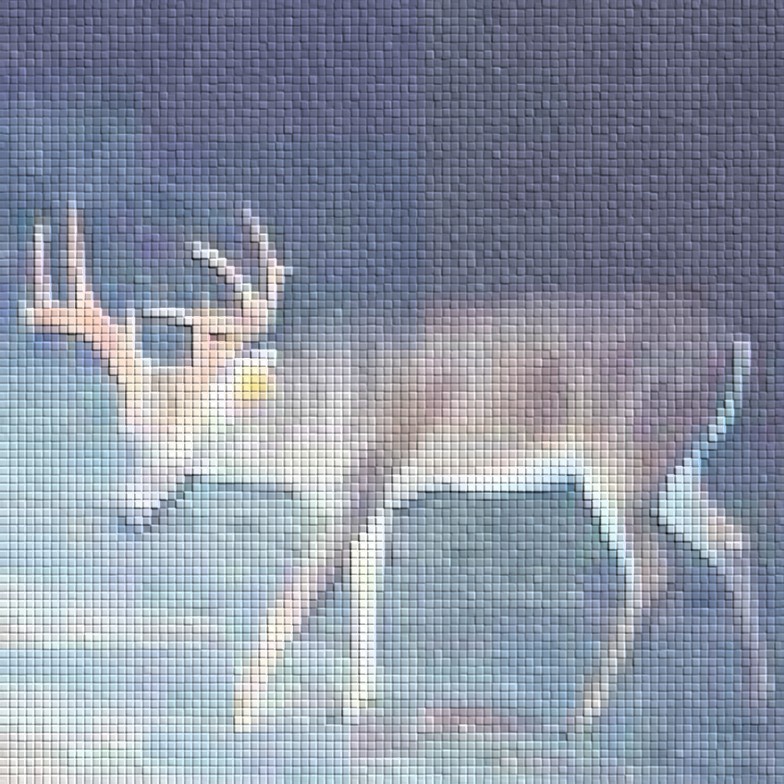
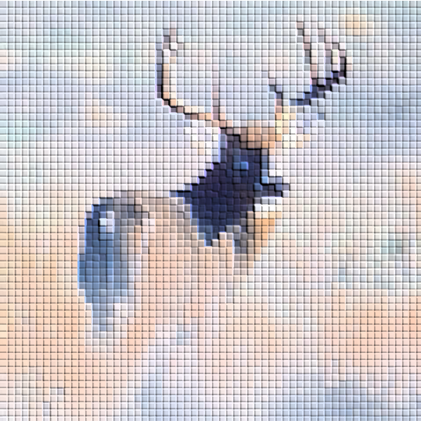
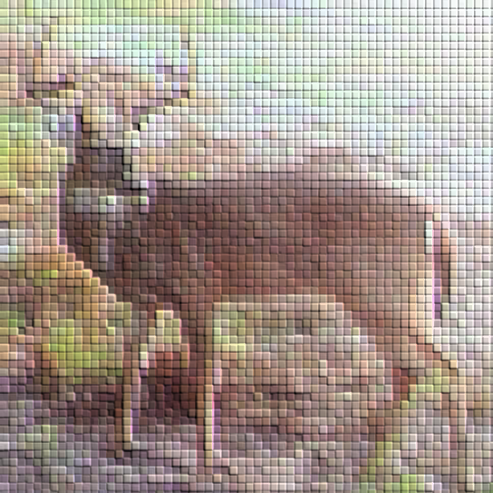
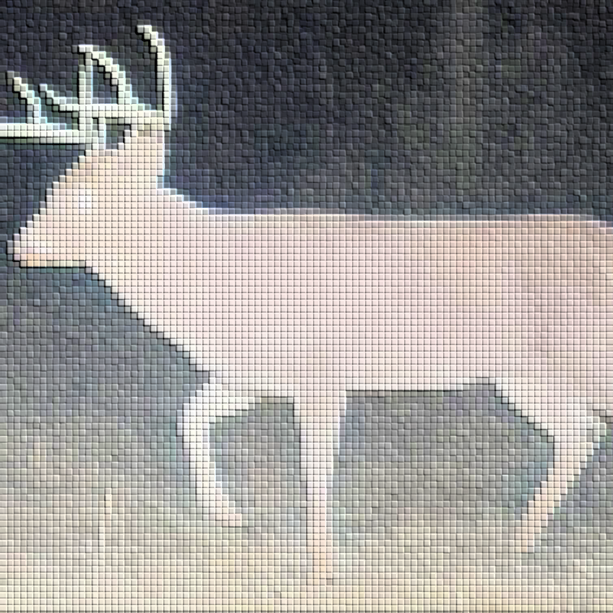
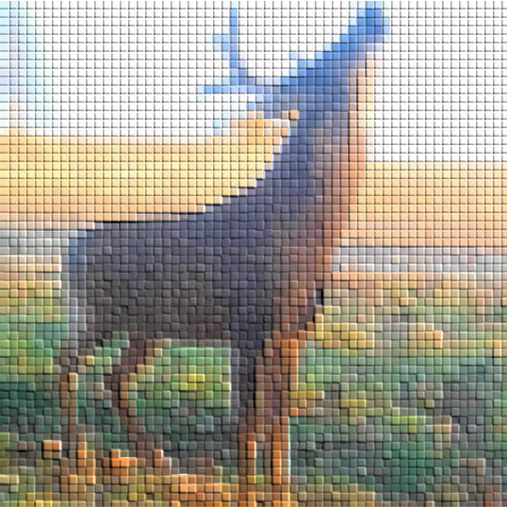
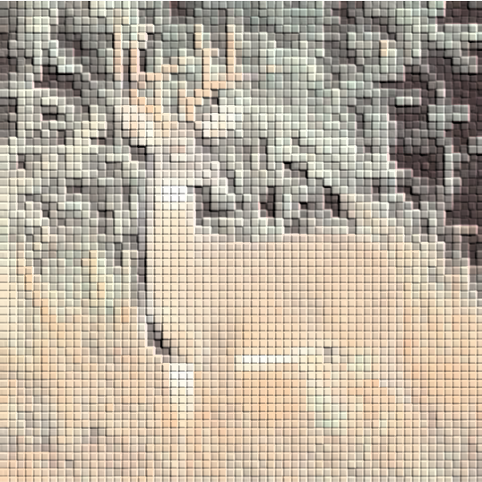
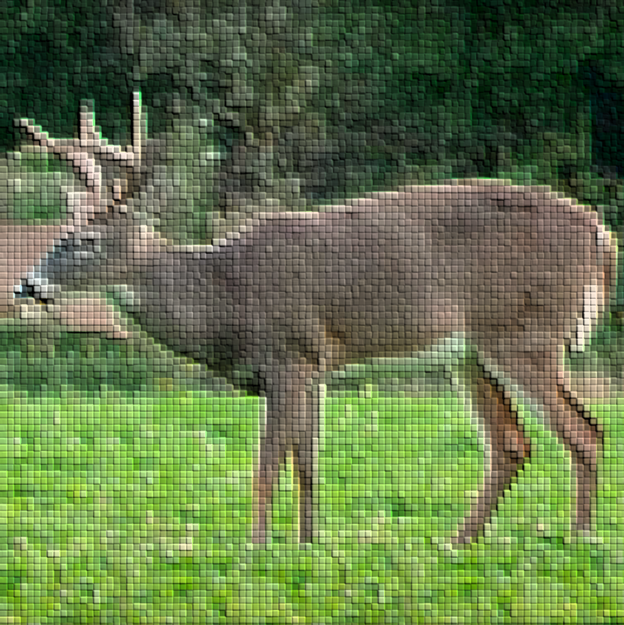
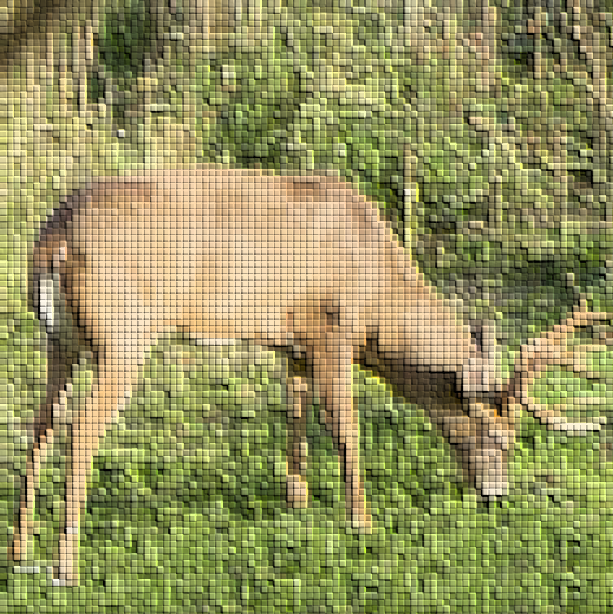
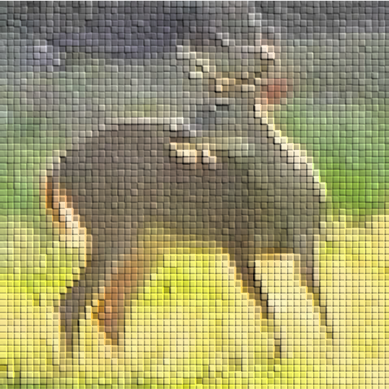
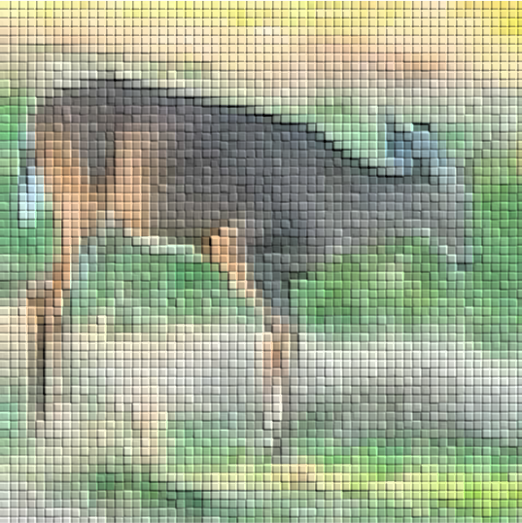
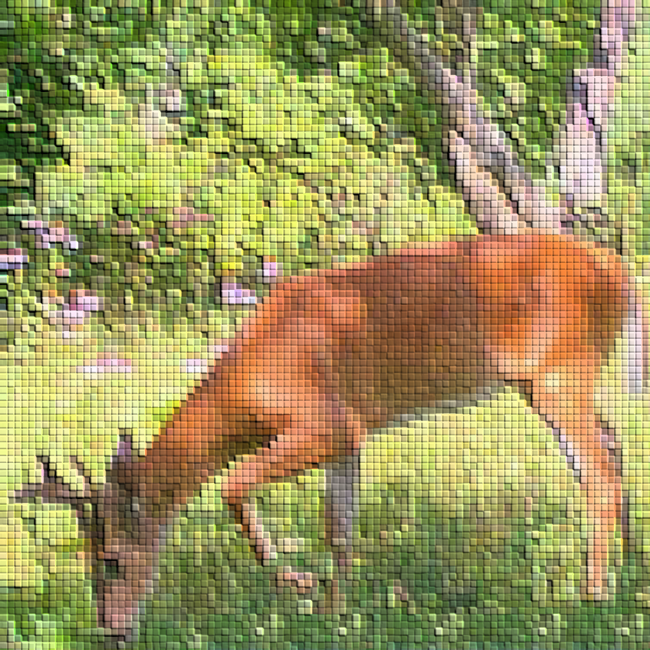
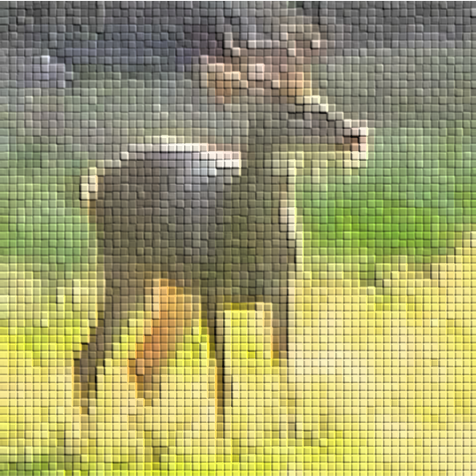
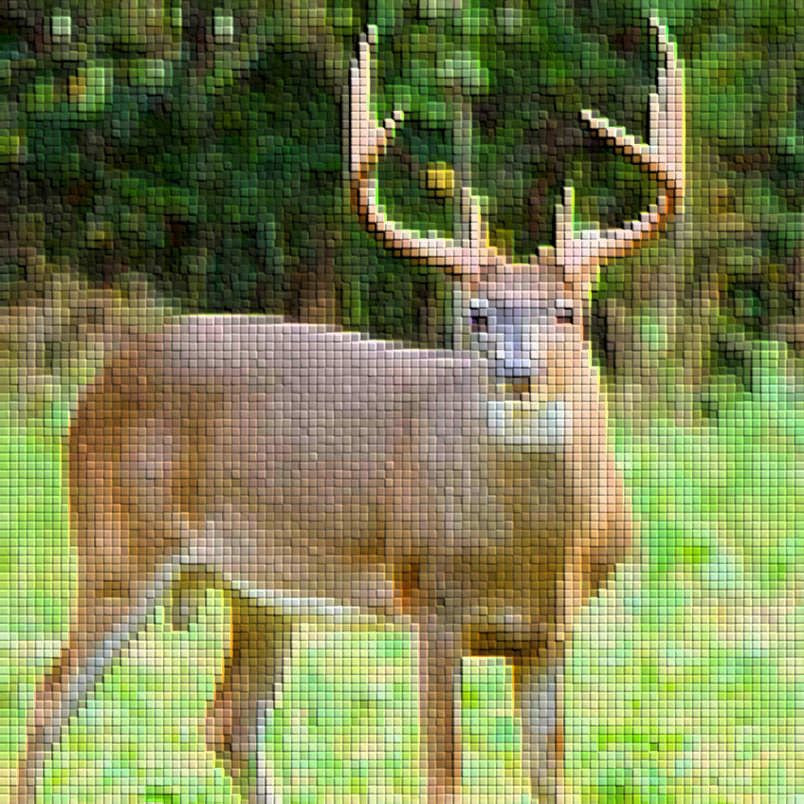
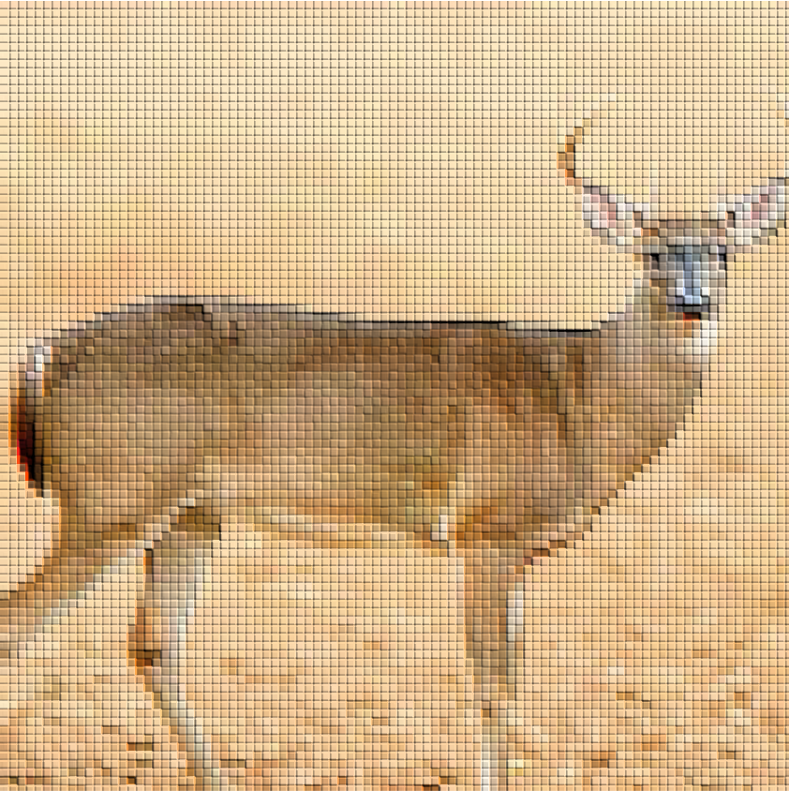
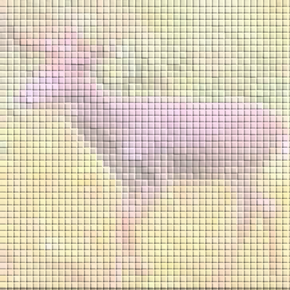
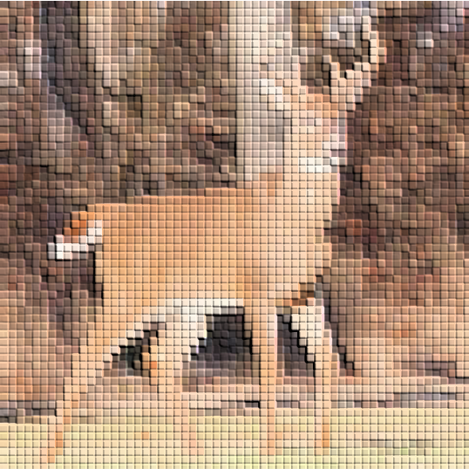
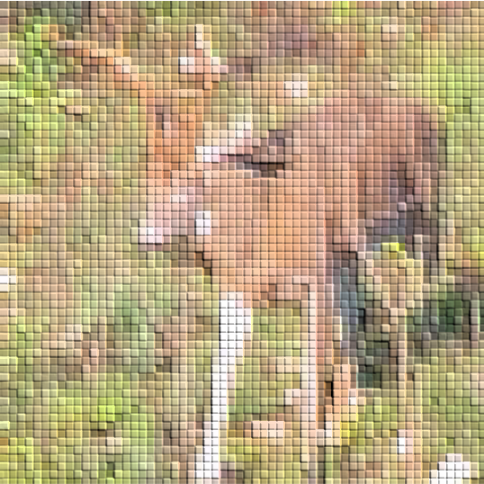
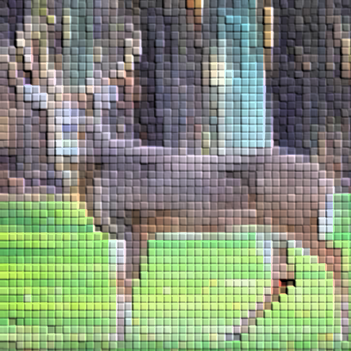
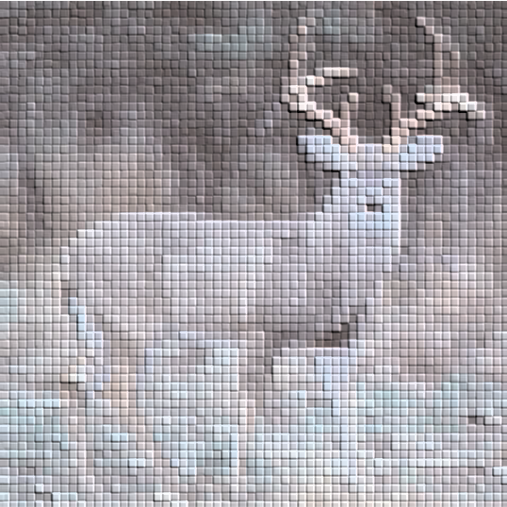

Slide 16
